Slide 1
Used Car Price Prediction
Shiyu Liu, Data Science Institute, 10/25/2024
https://github.com/lshiyu4210/data1030_project

Slide 2
Introduction
Problem Statement: Predict the price of a used car based on relevant features
Why It’s Important: help buyers and sellers make informed decisions, benefiting online trading platforms by improving pricing transparency and user trust
Problem Type: regression problem, continuous target variable—used car prices
Notes:
Problem Statement: Predict the price of a used car based on relevant features such as year, mileage, make, engine, and condition.
Why It’s Important: The U.S. has a large used car trading market. Accurate price predictions can help a lot of buyers and sellers make more informed decisions, while also benefiting online trading platforms by improving pricing transparency and user trust.
Problem Type: This is a regression problem, where the goal is to predict a continuous target variable—used car prices.

Slide 3
Dataset
Data Source: Kaggle: Used Car Price Prediction Dataset
Data Collection: Extracted from the popular automotive marketplace website, Cars.com
Release Date: Oct 22, 2023

Slide 4
Overview and Feature Engineering
Raw Dataset Dimensions: 4009 × 12
Dimensions After Processing: 4009 × 13
Features Removed: engine, transmission, model, int_col, ext_col
Features Added: horsepower, displacement, cylinders, turbo, transmission_type, gears
Other Features: brand, model_year, milage, fuel_type, accident, clean_title, price
Notes:
transmission_type: automatic or manual
clean_title: whether the car has legal dispute or not

Slide 5
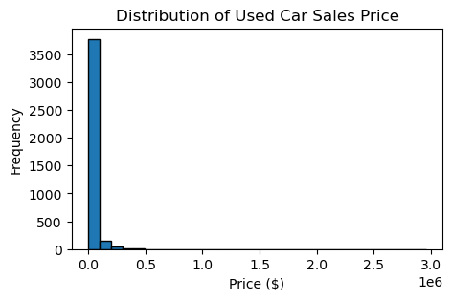
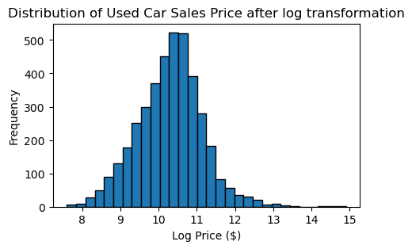
Target Variable: Sales Price
Reason: highly right-skewed sales price
Unexpected: luxury cars → outliers, inaccurate predictions
Solution: log transformation, normalize
Skewness Before and After: 19.514 → 0.106
Notes:
The target variable, used car sales price, is highly right-skewed due to the presence of luxury cars priced significantly higher than ordinary vehicles. These high prices create numerous outliers, which can lead to inaccurate predictions. However, removing these outliers would result in the loss of valuable information about luxury car prices. To address this issue, we apply a log transformation to the sales price, which helps reduce skewness and brings the distribution closer to normal, improving the model’s ability to make accurate predictions across all price ranges.

Slide 6
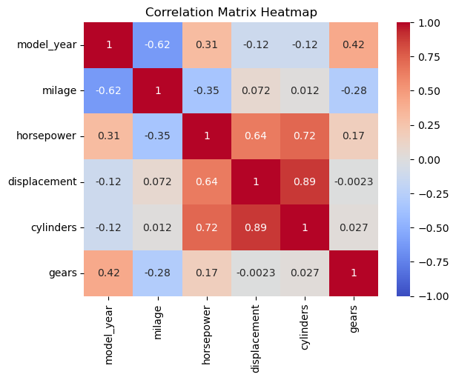
Heatmap of Continuous Variables
Reason: understand correlations between features
Interesting: high positive correlation between cylinders, displacement, and horsepower, but not gears

Slide 7
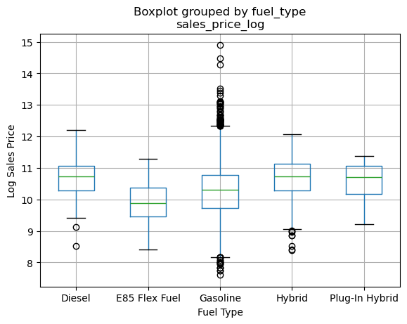
Boxplot of Log Price by Fuel Type
Reason: how fuel type influences car pricing
Important: median price of diesel, hybrid, and plug-in hybrid cars > E85 flex fuel and gasoline cars
Most outliers in gasoline cars
Unexpected: low price outliers in hybrid cars

Slide 8
Split and Preprocessing
Splitting: train_test_split (60-20-20)
Reason: iid data points, balanced proportion
Preprocessors: OneHotEncoder, StandardScaler, ColumnTransformer
Features: 12 → 75
Data Points: 2405(train), 802(val), 802(test). No changes.
Notes:
Describe briefly how you split the data and why. What preprocessors did you use and why? How many features and data points do you have before and after preprocessing.

Slide 9
Missing Values
Feature Name | Missing Fraction | Data Type
fuel_type | 5.41% | Categorical
accident | 2.82% | Categorical
clean_title | 14.87% | Categorical
horsepower | 20.15% | Continuous
displacement | 5.41% | Continuous
cylinders | 10.98% | Continuous
transmission_type | 12.20% | Categorical
gears | 45.72% | Continuous
Fraction of points with missing values: 0.608 → 0.596
Notes:
If you have missing values, describe the basic properties of the missing values (e.g., what fraction of the points have missing values, which features, what fraction of the features are missing, etc).

Slide 10
Q&A

Slide 11
Thanks for your time!

